Slide 1
Oscar Renalias
Accenture
Next-generation JavaScript
October 17, 2014

Slide 2

Ask questions or rate the Speaker
www.sli.do/openslava

Slide 3






@oscarrenalias
github.com/oscarrenalias
oscar.renalias@accenture.com
oscar@renalias.net
www.linkedin.com/oscarrenalias
www.slideshare.net/oscarrenalias

Slide 4
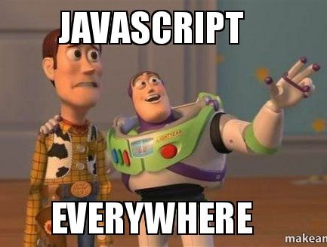
Notes:
I was here a year ago to talk about Node.js, so JavaScript on the server. And this year, well, forget that – we’re going with JavaScript everywhere, that’s my vision.

Slide 5
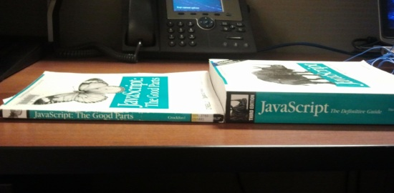
Notes:
And then someone makes fun of my vision… with this.
And today I am here to tell you more about what “next-gen JavaScript” is all about. And I am going to make the case that it is already here!

Slide 6

History lesson picture
(Very) Brief history of JavaScript
Notes:
But before we do that, let’s have a look at a very brief history of JavaScript.

Slide 7
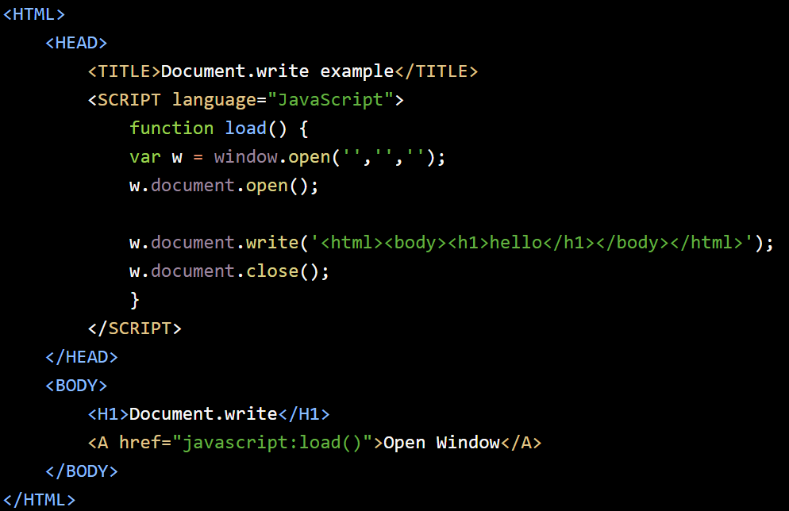

In the beginning there was JavaScript… on Netscape Navigator
Notes:
JavaScript started as a way to add some dynamic behavior to JavaScript pages. Does anyone still remember the days of window.open and then using JavaScript to create pop-ups with dynamic content, or form validation with JavaScript? Those were the days of DHTML and form validation… on Netscape.
JavaScript was first released as part of Netscape Navigator 2.0 in September 1995.

Slide 8


ECMAScript, the JavaScript standardization
1.0
1.1
…
1.8.5
Notes:
In the meantime, Microsoft gave JavaScript a try by including it in Internet Explorer 3.0 and calling it JScript. Jscript and JavaScript were exactly the same, but in those days, obviously Microsoft could not be caught copying a competitor’s product’s name!
Netscape submitted JavaScript for standardization to Ecma International, which resulted in several ECMAScript versions along the years.
To clarify, ECMAScript is a definition while JavaScript is just one of the possible language implementations. Other implementations of ECMAScript are Microsoft’s JScript as well as ActionScript.
Source: http://en.wikipedia.org/wiki/ECMAScript
Ecma International is an international, private (membership-based) non-profit standards organization for information and communication system. Ecma aims to develop standards and technical reports to facilitate and standardize the use of information communication technology and consumer electronics (source: http://en.wikipedia.org/wiki/Ecma_International).

Slide 9
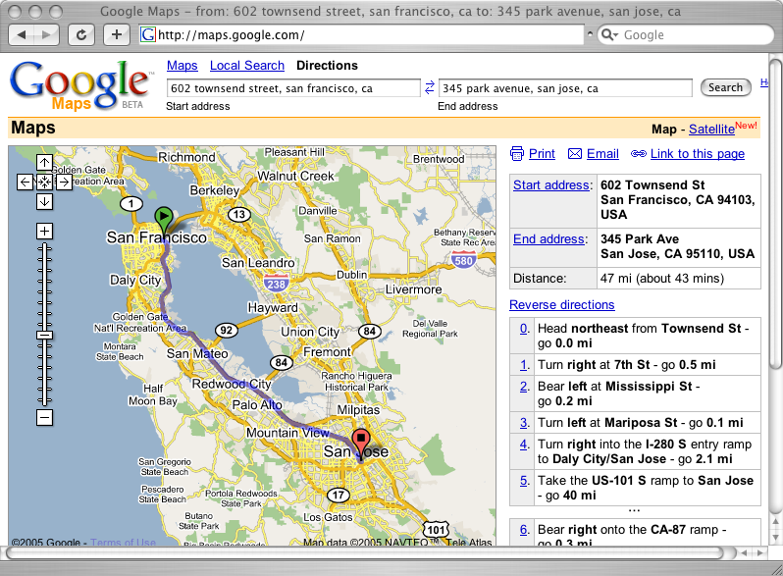
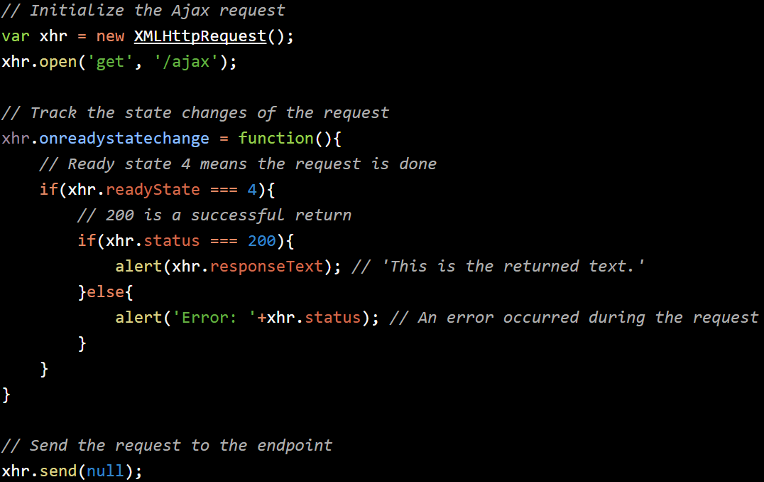
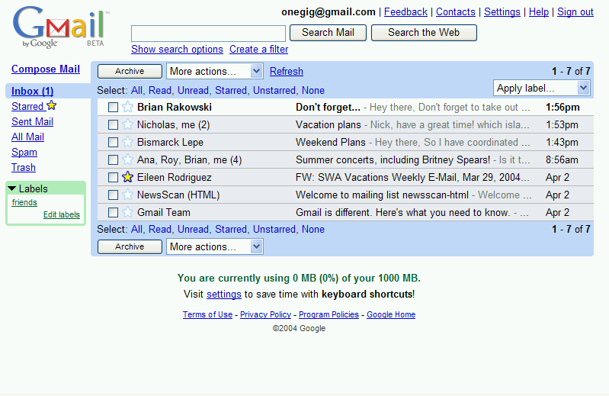
The Ajax era, and the rest is history
Notes:
To be fair to them, Microsoft created the first implementation of XMLHTTP ActiveX control in Internet Explorer 5, which was later adopted by Opera, Mozilla, Safari as the XmlHttpRequest object (and at that stage it was no longer an ActiveX control).
Does anybody here remember this type of prehistoric XmlHttpRequest handling logic?
The “Ajax” term was officially coined in Februray 2005 though Google had already been using this technique for their Gmail and Google Maps offering.

Slide 10
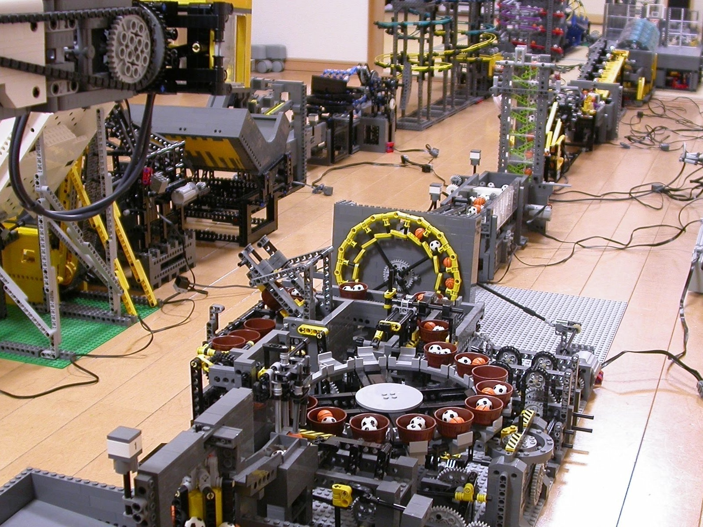
Maybe JavaScript and the browser can be used to run complex and engaging applications?
Notes:
And then we realized that maybe, maybe, maybe JavaScript and the browser can be used to run complex and engaging applications that replicate desktop-like experiences?

Slide 11

It’s time to raise the JavaScript game
Notes:
So it’s time to kick things up a notch in the world of JavaScript. But, how far are we from next-gen JavaScript?
A few slides ago I said that today I am here to tell you more about what “next-gen JavaScript” is all about… But now, let me make it clear: I am also going to make the case that it is already here!

Slide 12
Tools
Frameworks
Languages
Platforms
Standards
Notes:
In order to bring some structure to “next-gen” JavaScript, we’re going to look at these four main areas.

Slide 13

JavaScript standards, catching up with the times
Notes:
First, we start with the standards, which are decidedly catching up with the times.
Image source: http://publicclockthis.blogspot.fi/2013/07/sunderland.html

Slide 14
ECMAScript 6
ECMAScript is the standardized version of JavaScript
Classes
Block scoping with ‘let’
Destructuring
Generators
Comprehensions
Modules
Promises
Reflection API
Tail calls
Template literals
(and many more!)
Notes:
And the main standard for JavaScript, as mentioned before, is ECMAScript..
ECMAScript has had a few releases over the year (most recent released one is version 5) and now the committee is ready preparing ECMAScript 6 which is by far the most comprehensive release in a very long time. Some of these features have already been adopted as part of JavaScript 1.7/1.8 (like promises), and some of these, even if not officially approved, have already been adopted by state-of-the-art JavaScript engines such as V8 (some of these are available in Google Chrome).
Out of all the content in ES 6 (also called “Harmony”), some of the changes are mere syntactic sugar (“let”), others are standardization of features that have been provided by 3rd party libraries for a long time (promises) and some others will definitely and fundamentally change the way we develop JavaScript applications. I picked 3 of these as examples, let’s have a look at them.

Slide 15
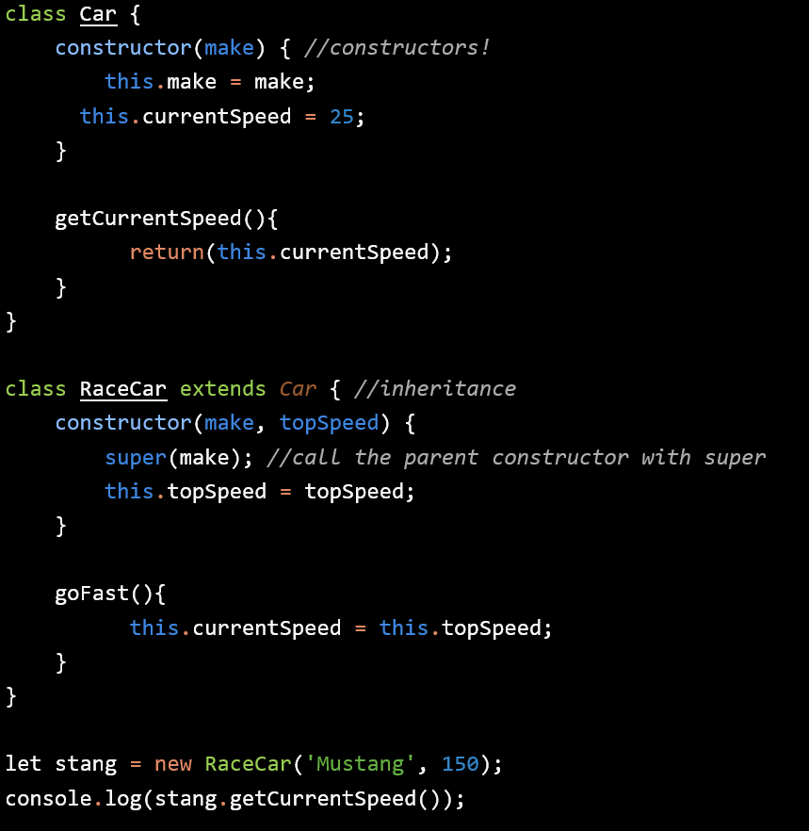
ECMAScript 6 – Classes and objects!
Notes:
First one: classes, and objects.
We did not cover the basics of JavaScript today but JavaScript is NOT an object-oriented language, but rather a prototype-based language… or in other words, it’s got something that looks like classes, but classes they’re not. However, ES6 does bring classes into the picture, just like an OOP language. While I don’t think that classes and objects are and end-all be-all paradigm, they’ll definitely help to structure code and applications better.
Source: http://www.wintellect.com/blogs/nstieglitz/5-great-features-in-es6-harmony

Slide 16
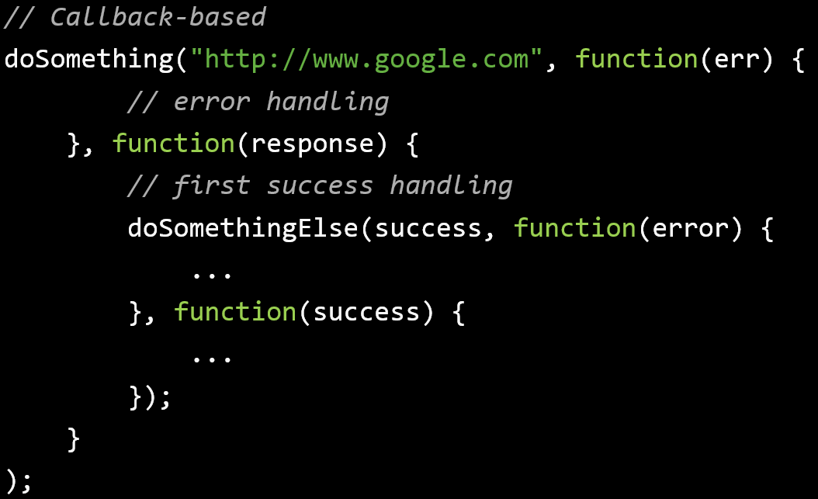
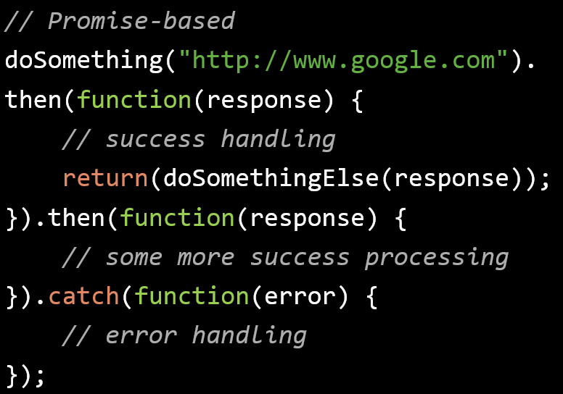
ECMAScript 6 – Promises, or “say goodbye to callback spaghetti”
Notes:
Second is promises.
Just look at a typical snippet of callback-based code where multiple asynchronous calls are chained because they need the data from the previous call, versus the same thing done with promises. It’s quite the change, and it should effectively solve the problem we’ve had with ‘callback spaghetti’ and ‘callback hell’.
There are quite a few libraries out there that provide support for promises (Q, RSVP, Angular’s $q) and while they all offered an interface that look familiar, they all worked in slightly different ways. ECMAScript 6 intends to remove all external dependencies for promises and standardize them.

Slide 17
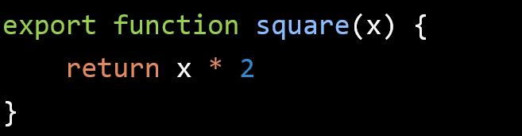
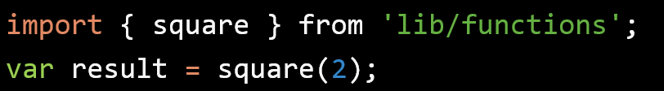
ECMAScript 6 - Modules
Export functionality (classes, functions, variables) from a module
Use exported functionality from anywhere else
Notes:
And third one is modules.
So far we’ve had the AMD specification and a couple of implementations such as Require.js, which has been fairly successful in the browser.
There’s also CommonJs, which is the standard for server-side code in Node.js.
ECMAScript 6 provides a common syntax that tries to combine both approaches.
More details: http://www.2ality.com/2013/07/es6-modules.html

Slide 18
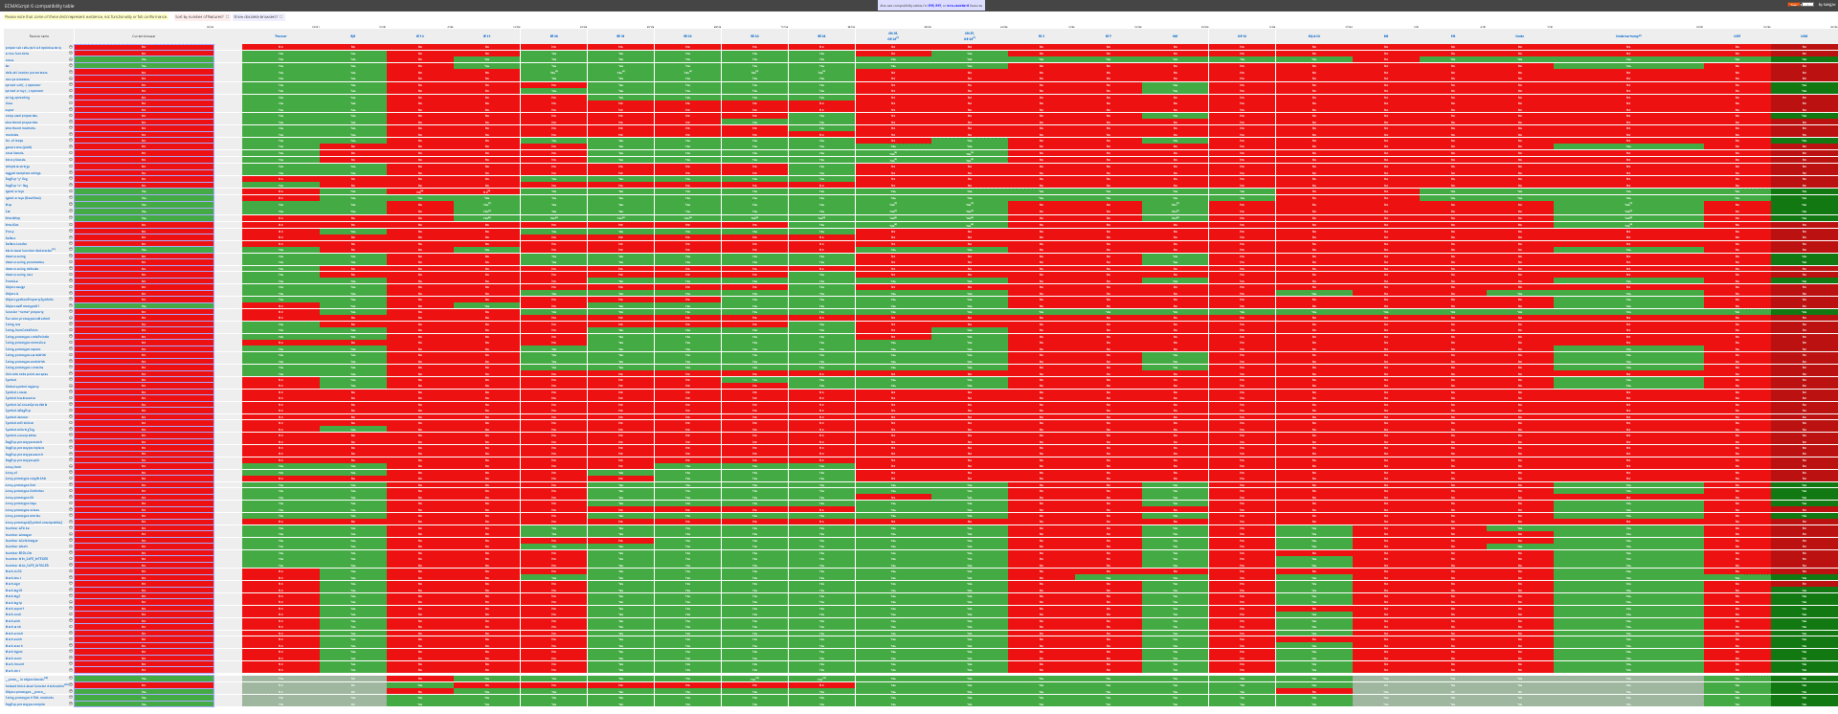
ECMAScript 6 Browser Support
http://kangax.github.io/compat-table/es6/
Notes:
Ok. I’m in. I want to go ECMAScript 6… which browsers support me? Well, 100%? None ☺

Slide 19
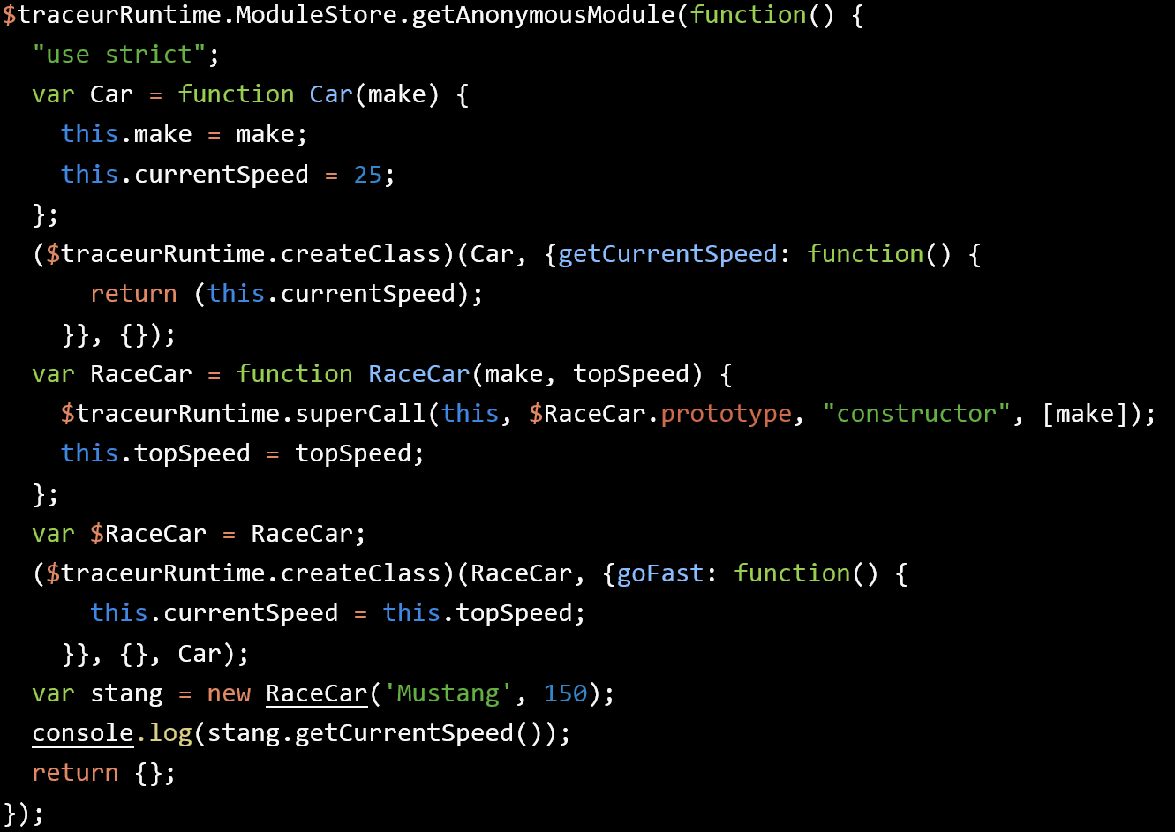

Traceur is a JavaScript.next-to-JavaScript of today compiler
Notes:
Browser support isn’t fully there yet so we cannot use any of this goodness?
Traceur can help us by providing a compiler that is capable of translating some (but not all) of the new ECMAScript 6 features into code that any older browser can run.
Traceur can be incorporated into Grunt for automated compilation and into a traditional Grunt-based build workflow so it is pretty painless.
Traceur can also generate source maps so that it’s possible to debug ECMAScript 6 source code even if it was compiled down to a lower version of the language.
If traceur is not an option, there are also ‘polyfills’ that implement some of then newer ES6 functionality in browsers that don’t support ES6 yet. Polyfills may be an option when only a small part of ES6 is needed (e.g. promises or modules) and we don’t want to drag along the entire Traceur compile for a small bit of functionality.

Slide 20
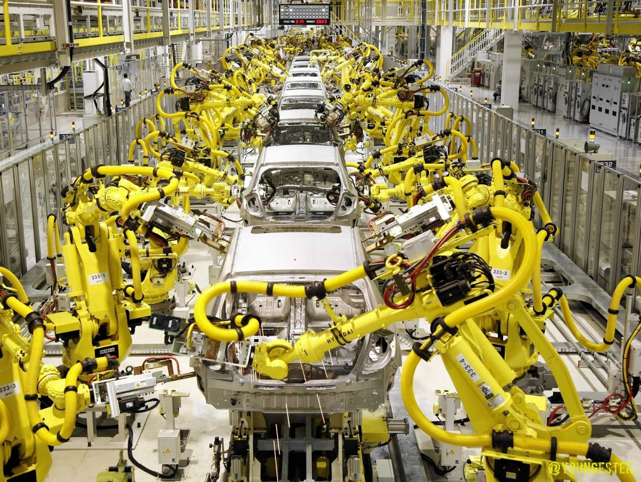
Languages, or “what if JavaScript is simply to become the assembly language of the web”?
Notes:
Now we’ve seen how I think that JavaScript standards have progressed towards their next-gen. And if we use a browser that is not there yet, no problem, use Traceur.
But what if JavaScript as a language could be totally replaced with something that is better, and we could build frameworks on top of a better language? Do we need to support multiple virtual machines in btowsers? No.
Full list of languages that compile to JavaScript: https://github.com/jashkenas/coffeescript/wiki/List-of-languages-that-compile-to-JS

Slide 21
Transpilers
Language
Transpiler
Notes:
We can use a transpiler.
Transpilers are a general term that is not exclusive to JavaScript but that have recently received a lot of attention there.
So language X comes in, it gets processed/compiled by the transpiler, and the output is JavaScript that any browser can run.
Transpiled code isn’t pretty and it would be very hard to debug if we didn’t have source maps; source maps allow browsers that understand them to let you read and debug the language that was transpiled even though the browser executes JavaScript, and that’s very handy. Source maps are supported in Chrome and Firefox.
So what potentially interesting languages do we have in the JavaScript world that get transpiled? Quite a few actually. To be honest, too many!

Slide 22

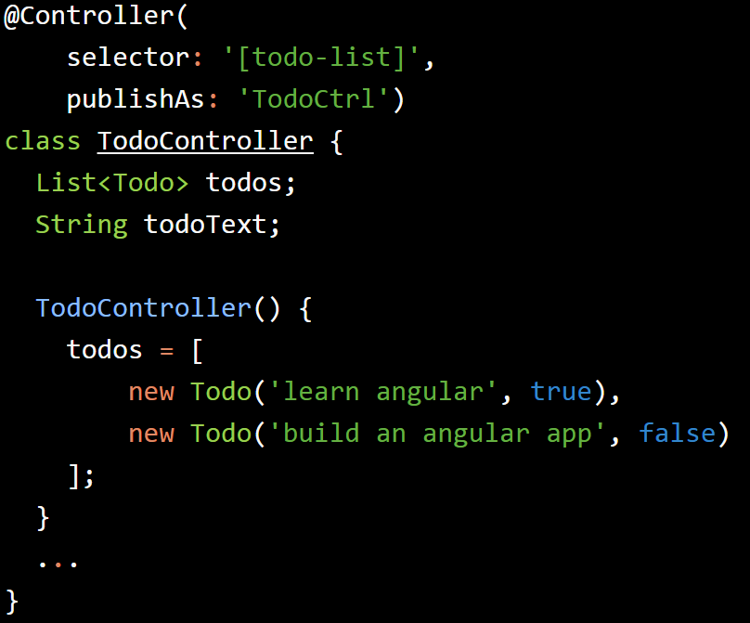
Dart
Classes
Optional typing
Annotations
Futures
Named constructors
(and many more)
Notes:
Dart’s value proposition is that of a language that can run on its own VM (the Dart VM) and be compiled to JavaScript for browsers without the Dart VM and that improves JavaScript in a number of ways:

Slide 23
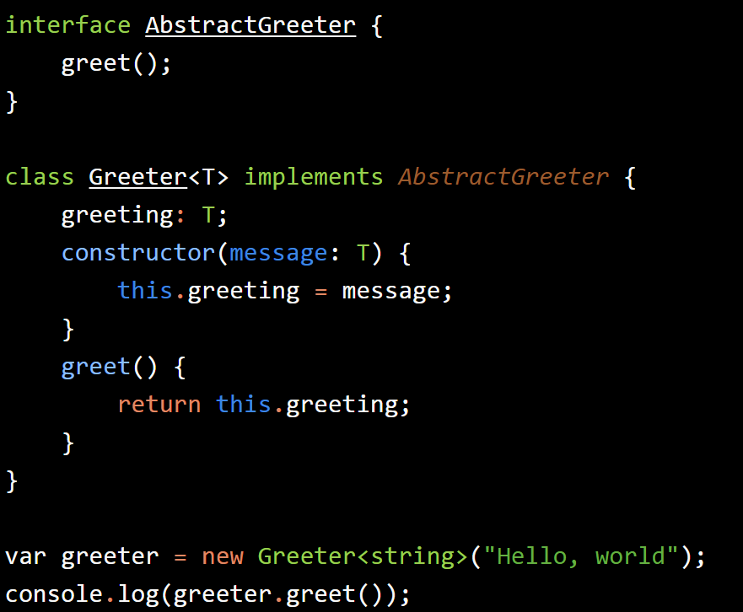
TypeScript
Classes
Interfaces
Modules
Optional typing
Generics
Notes:
TypeScript is a free and open source programming language developed and maintained by Microsoft. It is a strict superset of JavaScript, and adds optional static typing and class-based object-oriented programming to the language.
As TypeScript is a superset of JavaScript, any existing JavaScript programs are also valid TypeScript programs. TypeScript compiles to ES3-compatible JavaScript.
TypeScript supports header files which can contain type information of existing JavaScript libraries, enabling other programs to use objects defined in the header files as if they were strongly typed TypeScript objects.
TypeScript adds support for features proposed classes, modules and an arrow function syntax as they are proposed in the upcoming ECMAScript 6 standard.
Source: http://en.wikipedia.org/wiki/TypeScript

Slide 24



Honorable Mentions
ClojureScript
Scala.js
CoffeeScript
Notes:
Except CoffeeScript, both ClojureScript and Scala.js have solid computer science roots and they’re known for being solid (albeit a little difficult to pick up) languages.
Thanks to ‘transpilers’, it is now possible to compile any of them from their native Clojure and Scala code to JavaScript code that any browser can execute. They both pretty much provide the same features as if they were used in their intended environment (the JVM) and can interact with a higher or lower degree of friction with native JavaScript libraries such as jQuery.
CoffeeScript was designed as a “better JavaScript”. While I am personally not convinced that it achieved that goal, it still is a very concise and clean language that makes writing JavaScript code much more straightforward.
Clojure: http://clojure.org/
Scala.js: http://www.scala-js.org/
CoffeeScript: http://coffeescript.org/

Slide 25
Emscripten
C
C++
Emscripten
(LLVM)
Notes:
LLVM, formerly known as “Low Level Virtual Machine”.
LLVM was not designed as a transpiler, but as something more generic; the compiler generates some kind of intermediate bytecode and then that intermediate representation can be used to generate any output that we can think of: binary for native execution but also Java bytecode, or even JavaScript code.
I do not think that LLVM will be the main focus of next-gen JavaScript development processes but it can be used in specific scenarios where we are converting complex applications to run in the browser… For example, the JavaScript Quake 3 port ☺.
Source: http://en.wikipedia.org/wiki/LLVM

Slide 26

Raising the game with JavaScript frameworks
Notes:
After standards and languages, it’s time to put things together and build next-generation frameworks that exploit our next-gen capabilities!
This is by no means a comprehensive list of frameworks, but only an opinionated list of those that can, at the moment, make (or already making) the most dramatic impact to JavaScript next-generation applications.
Image source: http://upload.wikimedia.org/wikipedia/commons/b/b7/Lorimerlite_framework.JPG

Slide 27
JavaScript Frameworks
MV*
Component-oriented
Isomorphic

Slide 28



MV* Frameworks
Generally MV* - MVC, MVP, MVVM, etc
Support for 2-way data binding
Integration with HTML5, e.g. back button history API support
Templates
Notes:
There are literally hundreds of JavaScript client-side frameworks but if we look back in 10 years at what are the ones that were for one reason or another the most important ones, I think that 98% of us would agree with this list: Angular, Ember and Backbone.
Although there are low-level differences in how things are done with each one of them, they all offer pretty similar capabilities:
MV-something
2-way data binding (so updating a model causes an update to the view, and viceversa – all automatically)
Integrated with HTML5 features such as the history API so that the back and forward buttons can be used just like in a normal site made up of static pages
Templates, integrated in one way or another with the framework, e.g. Backbone can work with several template engines while in Angular it is built-in
Compared to stitching together an application with jQuery, these do feel next-gen.
Out of this list, my experience is with Angular and I can say that it makes building complex JavaScript applications a breeze. And when thinking of next-gen, Angular 2.0 is really looking to deliver a great development experience incorporating features of ECMAScript 6 and using Traceur to transpile to code that older browsers can run.

Slide 29

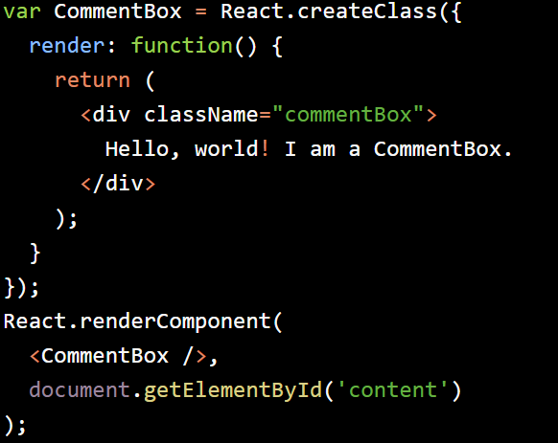
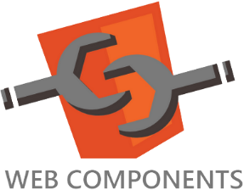


Component-oriented frameworks
Applications are made up of independent components that use each other to display data
React
Polymer
X-Tag
W3C Component Spec
Notes:
Source code: http://facebook.github.io/react/docs/tutorial.html
But next-gen JavaScript is also about evolving development paradigms and something that I believe will gain some relevance over the coming years is component-oriented development, where applications are built out of independent UI components that talk to each other to achieve application functionality.
One of the most interesting is Facebook’s React.

Slide 30
AngularDart leverages Dart’s features to make web app development better
Improved dependency injection
Types
Class-/object-based
Annotations rather than boilerplate code
Notes:
Another interesting framework is AngularDart; out of the frameworks I’m showing here this one is the most experimental of all. I would currently not recommend it for production use but it’s a great example of what can be achieved when we take a clean language and create a web framework on top of it.

Slide 31

Isomorphic JavaScript – write code once, run in client *and* server
Meteor
Isomorphic JavaScript frameworks use techniques such as Browserify and virtual DOMs to be able to render content and templates regardless of where the application runs
Derby
Notes:
Isomorphic JavaScript is a technique grown from the fact that sometimes non-Js clients need to be supported while at the same time we want to provide a great front-end experience for those clients that do run JavaScript. So, we should write application functionality twice, once in a traditional JavaScript framework for Js-capable frameworks and once for non-Js frameworks?
The answer is, obviously, no ☺.
Isomorphic frameworks let us write (and run!) the same code both in the server and in the client. It relies on things like virtual DOMs, Browserify and Node.js on the server to run the exact same code in the front and in the back.
Meteor, Rendr and Derby are the most interesting options to come from the isomorphic camp.

Slide 32

JavaScript Next-Generation Tooling
Notes:
Image source: http://theperfecthidingplace.blogspot.fi/2012_11_01_archive.html.
Last but not least: tooling.
What good are languages and frameworks if the tooling sucks?

Slide 33


Development automation with Grunt and Gulp
Live reload
Trask triggering based on changes to files
Automated minification and concatenation
Code compilation, integration with Dart, TypeScript, others
Packaging and Deployment
Automated LESS/SASS compilation
…and many more!
Notes:
First, task-oriented automation with Grunt and Gulp.
For those of you who may have used Ant or Maven, these are the equivalent tools in the JavaScript world.
Grunt is somewhat more mature as it’s been around for a while. Gulp is younger but it’s technologically speaking it’s a bit more interesting since it aims to structure our build tasks as flows of tasks that pipe inputs and output into each other, like a stream.
Both are equally good. If only I had to say something, I’d suggest that you look at the plugins available for each and make sure that there’s something available for all the peculiar things that you may need to do during the build process.

Slide 34

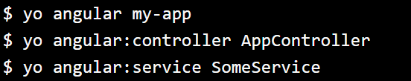
Automating application bootstrapping and code generation with Yeoman generators
Notes:
Yeoman is a code generation tool.
As such, it can be used to automatically generate boilerplate code as long as there’s a generator that knows how to do it. There are hundreds of generators already available and creating custom ones (say, as part of your own project) is not a very big task.
Automated code generation is very nice because a single command, like shown in the slide, can build a running application skeleton with a single command.

Slide 35


Package and dependency management
Bower (browser development) and NPM (Node.js development) provide world class support to manage 3rd party dependencies for any type of JavaScript application.
Notes:
Not too long ago handling 3rd party dependencies in front-end JavaScript development was a matter of keeping static copies of those dependencies in some libs/ folder, and then we struggled to keep that list of dependencies updated.
And then bower was introduced. For those of you who have Java experience, Bower is to JavaScript what Maven’s dependency management is to the Java world. It’s a great and very flexible too.
And npm is the same thing but for server-side Node.js development.

Slide 36




Testing and Quality
Unit testing
Mocks and spies
Browser testing
Rule-based code checks
Complexity analysis
Test coverage
Static code analysis
Istambul
mocha
ScanJs
Plato
Notes:
Last but not least, a few more tools:
JsHint: http://www.jshint.com/ - rule-based code analyzer
SonarQube JavaScript plugin: http://docs.codehaus.org/display/SONAR/JavaScript+Plugin – well-known Java-based static code analyzer, which has support for JavaScript via plugins. SonarQube is a great tool and its support for JavaScript makes it invaluable.
Istambul (code coverage): http://gotwarlost.github.io/istanbul/ - Code coverage tool for JavaScript
Plato (code complexity): https://github.com/es-analysis/plato - Code complexity analyzer
ScanJs (code analysis): https://github.com/mozilla/scanjs – Static code analyzer, developed by the Mozilla team
Jasmine – BDD framework
Mocha – Test execution
Chai
PhantomJs – headless WebKit for browser testing

Slide 37

Platforms
Notes:
Source: http://upload.wikimedia.org/wikipedia/commons/a/ab/Oil_platform_P-51_(Brazil).jpg

Slide 38
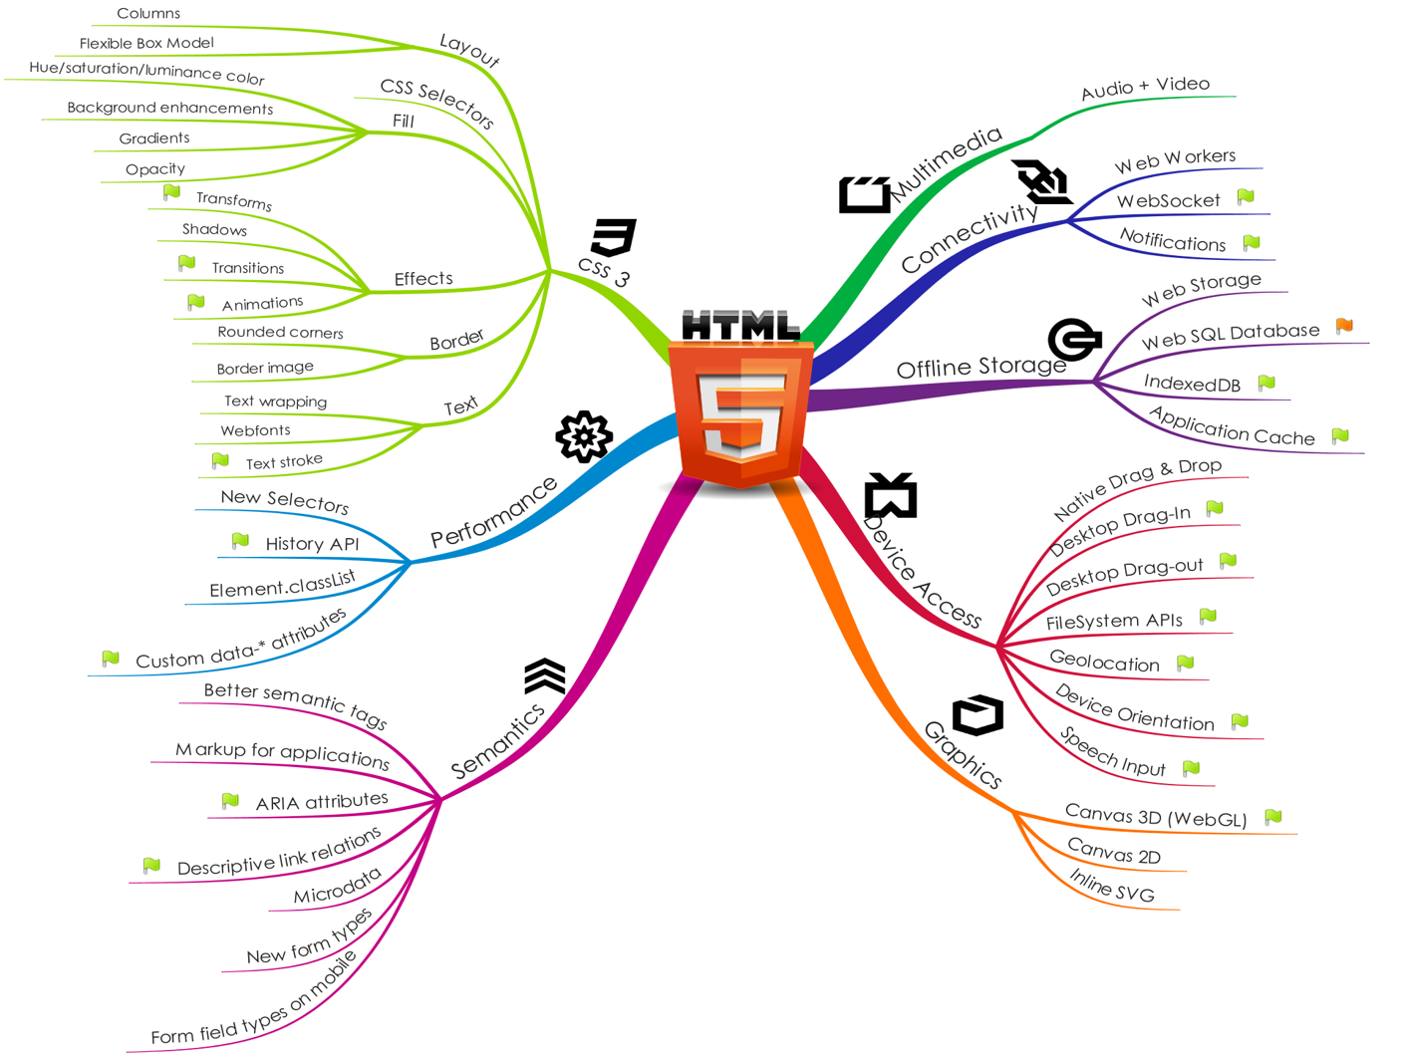

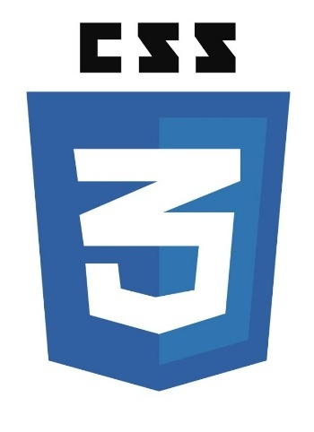
We wouldn’t be able to develop next-gen JavaScript applications without HTML5, CSS3 and the HTML APIs
http://platform.html5.org
Notes:
Source: unknown.
List of HTML5 platform APIs: http://platform.html5.org/
We wouldn’t be able to do next-gen JavaScript applications without a HTML5 and CSS3, and the vast array of HTML5 APIs that are currently provided by the browser.

Slide 39



And state-of-the art JavaScript virtual machines
(SpiderMonkey)
(Nitro)
Notes:
Sources:
History of JavaScript engines: http://en.wikipedia.org/wiki/JavaScript_engine
Each major browser has its own vision for a virtual machine, and competition is proving to be great with the virtual machines outdoing each other every few releases.
And they’re truly advanced. JIT compilation to native code, multi-stage compilers, etc. Whatever it takes to become the fastest.

Slide 40

JavaScript on the server too?

Slide 41

Node.js is an asynchronous, event-based JavaScript platform for server-side applications running on the V8 JavaScript engine
Notes:
Please to my presentation from last year for more details ☺

Slide 42

Nashorn
Notes:
Even Oracle is catching up with the times with Nashorn, which is the next-generation JVM-based JavaScript engine that allows JavaScript code to be run on the Java virtual machine.
There are a couple of interesting projects already happening on Nashorn, the most interesting of the bunch being Avatar.js which is an implementation of the Node.js standard library on Nashorn and JVM that will effectively allow Node.js applications to run unmodified on the JVM.

Slide 43
To conclude…

Slide 44
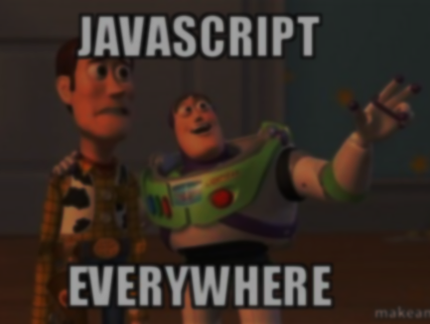
Tooling
Standards
Frameworks
MV*
DartAngular
React, Flight, etc
Isomorphic Frameworks
Express, Koa, etc
Istambul, Plato, etc
HTML5 APIs
Languages
SonarQube
TypeScript
Dart
CoffeeScript
ClojureScript
Transpilers, Emscripten
Scala.js
CSS
JsHint
JavaScript
Grunt
Platforms
Nitro
SpiderMonkey
V8
Node.js
Nashorn
Gulp
Yeoman
ECMAScript
Notes:
Next-gen JavaScript is already here and we’re definitely able to address all the building blocks that we established in the beginning.

